Slide 1
On – Prem AI Lab
A 48 GB GPU-based air-gapped AI workstation for local inference, RAG, and AI-assisted banking workflows.

Slide 2
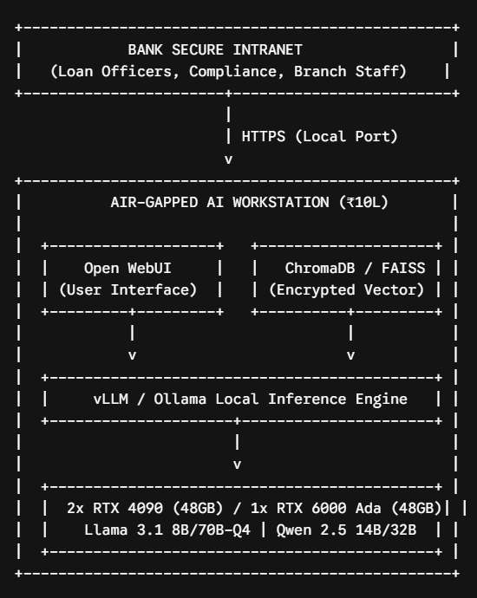
Prototype System Capabilities
The hardware is configured as a high-density, air-gapped AI workstation (equipped with 48 GB of high-speed GPU VRAM and 128 GB of ECC system memory).
This setup is optimized for local inference, fine-tuning parameter-efficient adapters (LoRA/QLoRA), and secure Retrieval-Augmented Generation (RAG).
Features
Zero Egress Compliance
Document Intelligence and RAG
Concurrent Throughput
Token Cost Elimination
Boundaries
Training from Scratch
Enterprise Wide High Concurrency
Mass Multi-modal Video Analytics

Slide 3
Implementation Roadmap
Phase | Duration | Core Focus | Major Deliverable
Phase 1 | Months 1–2 | Hardware Procurement, Site Prep & Assembly | Operational air-gapped physical workstation
Phase 2 | Months 3–4 | Local AI Stack Deployment & Baselining | Working internal chat interface with base models
Phase 3 | Months 5–6 | Knowledge Ingestion & RAG Pipeline Setup | Automated policy and circular lookup system
Phase 4 | Months 7–8 | Departmental Pilot & Security Hardening | Live user testing with Credit & Compliance teams
Phase 5 | Months 9–10 | ROI Audit, Token Accounting & Expansion Case | Executive report detailing savings and next steps

Slide 4
Budget Breakdown
Item | Component Specification | Est. Cost (INR)
Compute / GPUs | 2x NVIDIA RTX 4090 24GB (or 1x RTX 6000 Ada 48GB, depending on availability) | ₹ 5,20,000
Processor (CPU) | AMD Ryzen Threadripper 7960X (24-Cores, 48-Threads, high PCIe lanes) | ₹ 1,40,000
Motherboard | TRX50 Workstation Board (PCIe 5.0 multi-GPU support) | ₹ 75,000
Memory (RAM) | 128 GB DDR5 ECC Registered Workstation Memory | ₹ 65,000
Storage | 2x 2TB Enterprise M.2 NVMe Gen 4 SSDs (RAID-1 configuration) | ₹ 35,00,0
Chassis & Power | Full-Tower High-Airflow Chassis + 1600W 80+ Titanium PSU | ₹ 45,000
Thermal Management | Heavy-duty AIO CPU Liquid Cooler + High-CFM Industrial Case Fans | ₹ 20,000
Power Protection | 3 kVA True Online Double-Conversion UPS (with 30-minute full-load backup) | ₹ 45,000
Networking & Setup | 10GbE Network Interface Card, shielded CAT6A runs, and integration consumables | ₹ 25,000
Contingency Buffer | Taxes/freight variances, mounting accessories | ₹ 30,000
Total Project CapEx |  | ₹ 10,00,000

Slide 5
Success Criteria
Information Retrieval Accuracy: Target ≥90% precision on policy queries, verified against a manual audit of citations by the compliance team.
System Availability & Latency: Target 99.5% local uptime with an average first-token response time under 1.5 seconds across the internal network.
Cloud Token Cost Avoidance: Document the total tokens generated during the 10 months and compare that figure to equivalent commercial API rates, demonstrating the point at which the ₹10 Lakh investment fully amortizes itself.

Slide 6
Memory Limitations Remediations
Aggressive Quantization
Our team will use 4-bit or 8-bit quantization (methods like AWQ or GPTQ) which shrinks the model’s weight footprint by upto 70%
Capping the context window
Engineers must manually limit the model's context window. This stops any single employee from pasting an entire codebase and accidentally crashing the server for everyone else.
KV Cache Quantization
By quantizing the KV cache down to 8-bit, the server can instantly handle double the amount of concurrent users with virtually zero loss in answer quality.
Strict RAG Chunking

Slide 7
Models
Code Generation & Developer Models
Qwen3 – Coder (approx. 32B)
Devstral2
Laguna XS 2.1
Policy RAG & Compliance Reasoning
Qwen3.6 (27B or 35B – MoE)
Gemma 4 (31B)
Ultra Low Latency (Tab-Autocomplete)
Smaller Qwen3-Coder or Gemma 4 Edge variants (7B to 9B)
The "Hidden" RAG Infrastructure Models
Embedding Model (e.g., BGE-M3 or Nomic-Embed-v1.5)
Cross-Encoder / Reranker (e.g., BGE-Reranker-v2/v3):

Slide 8
Similar Implementations
SBI Life Insurance
SBI Life deployed an internal platform called "InsightGenie". This is an AI-driven data insights platform explicitly built as a secure, on-premise solution. It allows their internal teams to access, analyze, and query multi-layered proprietary performance data without exposing that financial telemetry to external cloud networks.
MUFG (Mitsubishi UFJ Financial Group)
MUFG has deployed on-premise, air-gapped AI workflows specifically designed for core banking compliance. By using localized platforms, they can run deterministic AI tasks—like KYC document processing, AML (Anti-Money Laundering) checks, and loan underwriting automation

